Slide 1
Lucas Faijdherbe
Harsh Khandelwal
Luuk van Beelen
Ruben van der Ham
Digital experience designers
ADAM & AOKI

Slide 2
US
Lucas - CS student
Ruben - CS student
Harsh - CS student
Luuk - IMM student

Slide 3
PROJECT SETUP
Research
Testing
Polishing
(Web)Design
Was actually not a linear process at all!

Slide 4
RESEARCH

Slide 5
First stage: static modelling
Personas
Scenarios
Use cases

Slide 6
Personas
Jack
Grandfather
New with phones/tech
Must be easy to order
Website must be safe and minimalistic
Zakaria
Athlete
Wants information about sunlight risks
Product must be durable
Would like to be informed of future events / products

Slide 7
Personas
Richard
Investor
Wants to see a unique story
Cares about details
Company should take one extra step to make world a better place
Fiona
Mother
Cares about health (and risks)
She’s the ‘connector’, if one mother has this, she tells others, and so on...
Convince her -> own the market
Is busy, so goal (buying, informing) should be reached quickly

Slide 8
Scenarios
How our Personas came across ADAM&AOKI and bought their shirt
Via Social Media, “Top 10 summer gifts” articles on the internet (third party sites)
Why Investors (Richard) wanted to invest in ADAM&AOKI
Unique details, scalable idea, helps humanity
How athletes (Zakaria) wants to engage with ADAM&AOKI
Newsletter, community forum

Slide 9
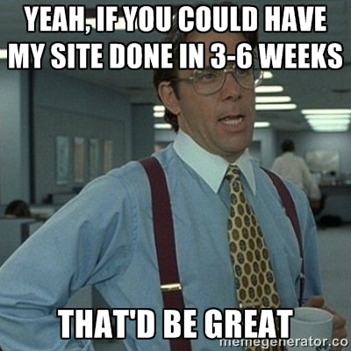
(WEB) DESIGN

Slide 10
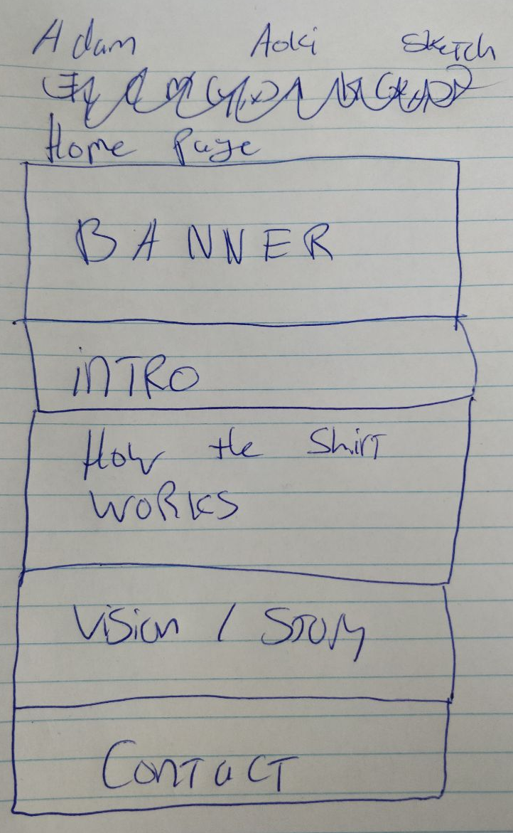
LO-FI prototype
Black and white
Not accessible
Basic layout only

Slide 11
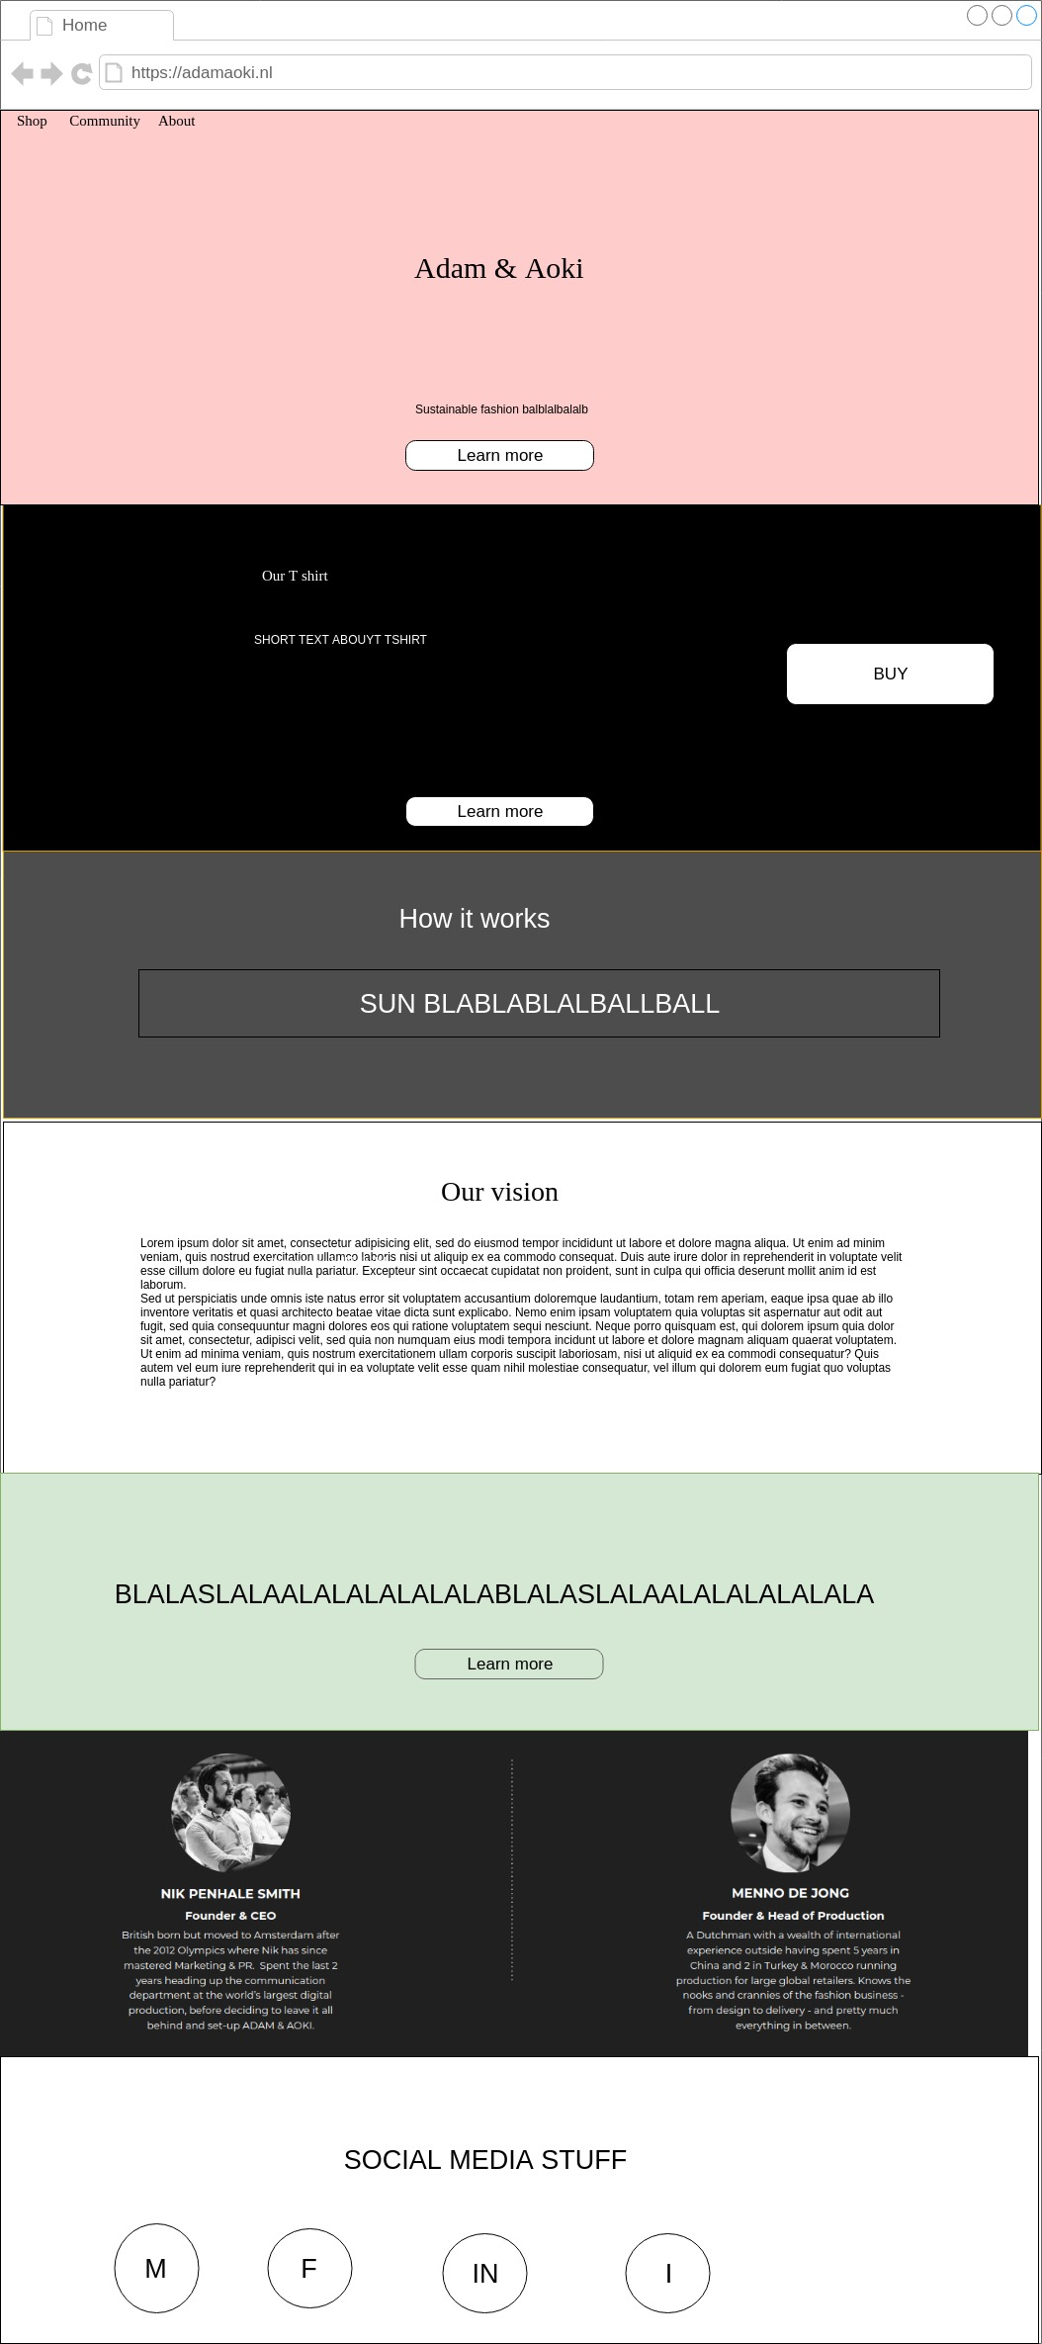
HI-FI prototype
Little colour
Somewhat accessible
A little bit more realistic

Slide 12

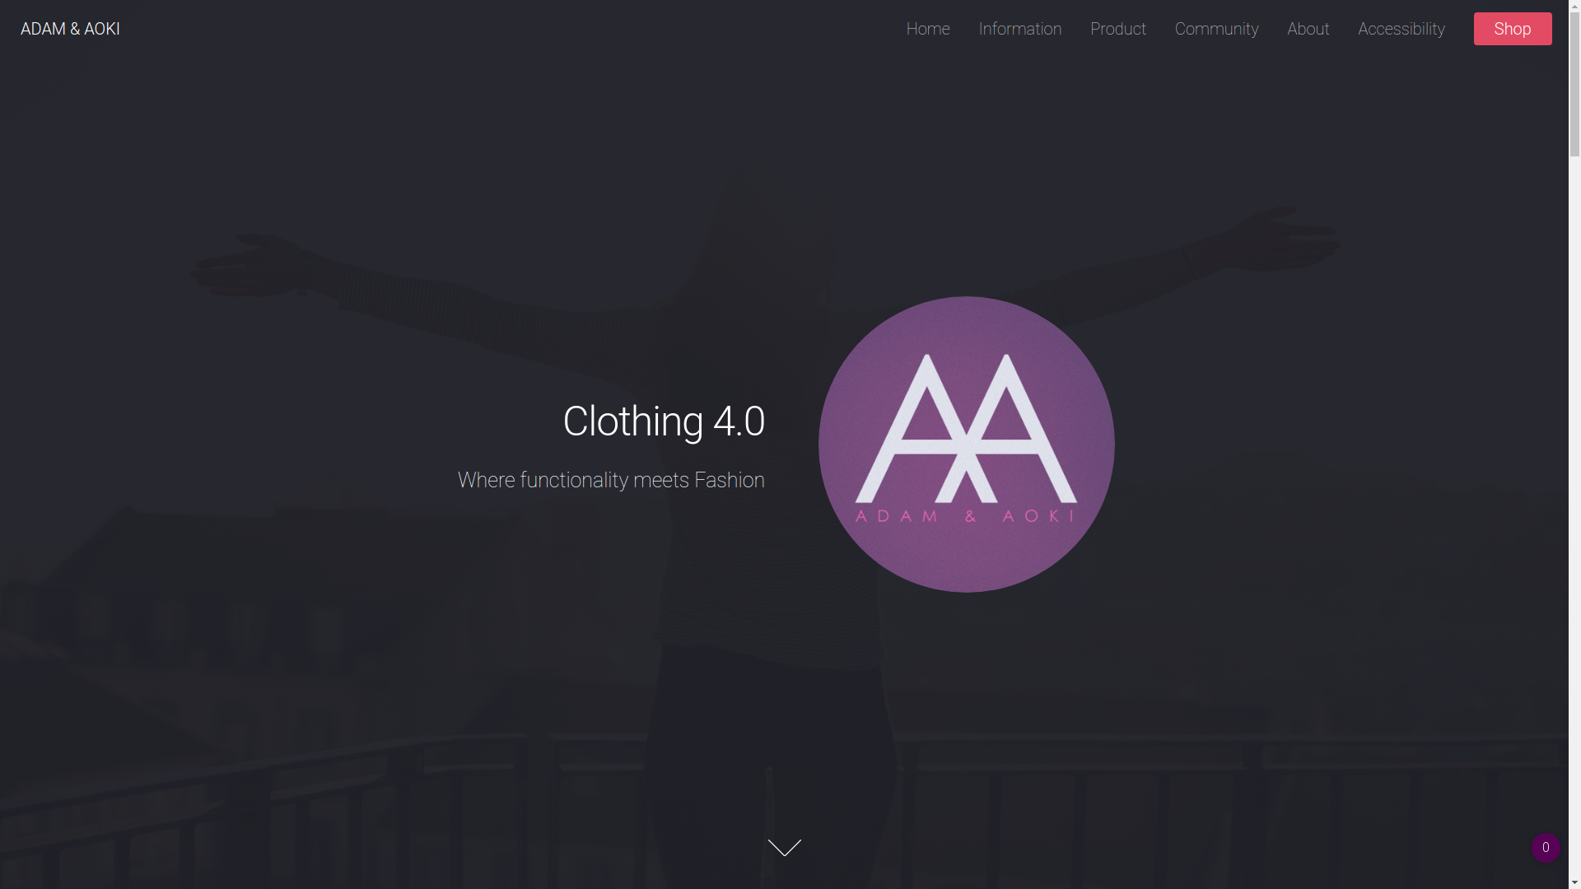

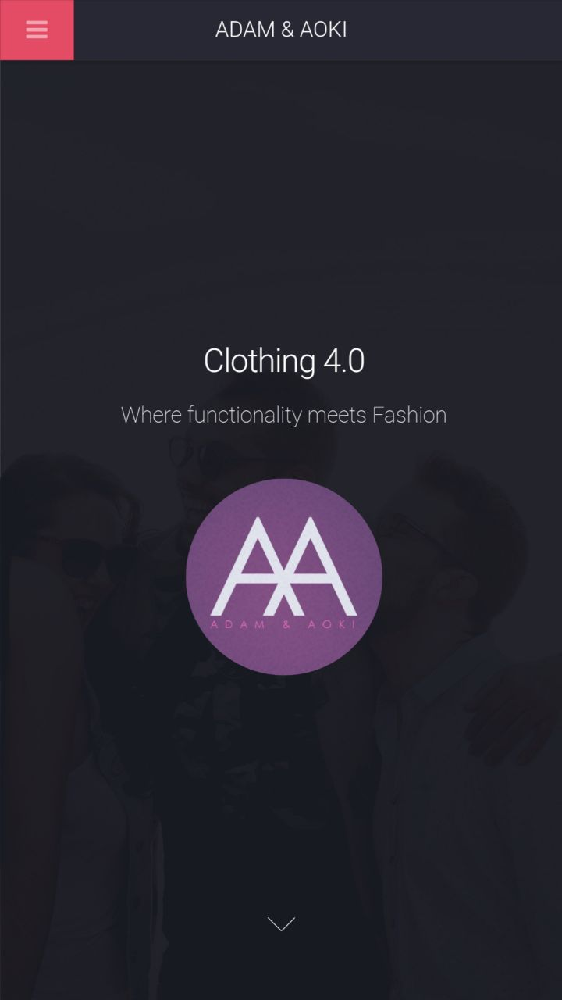
Milestone

Slide 13
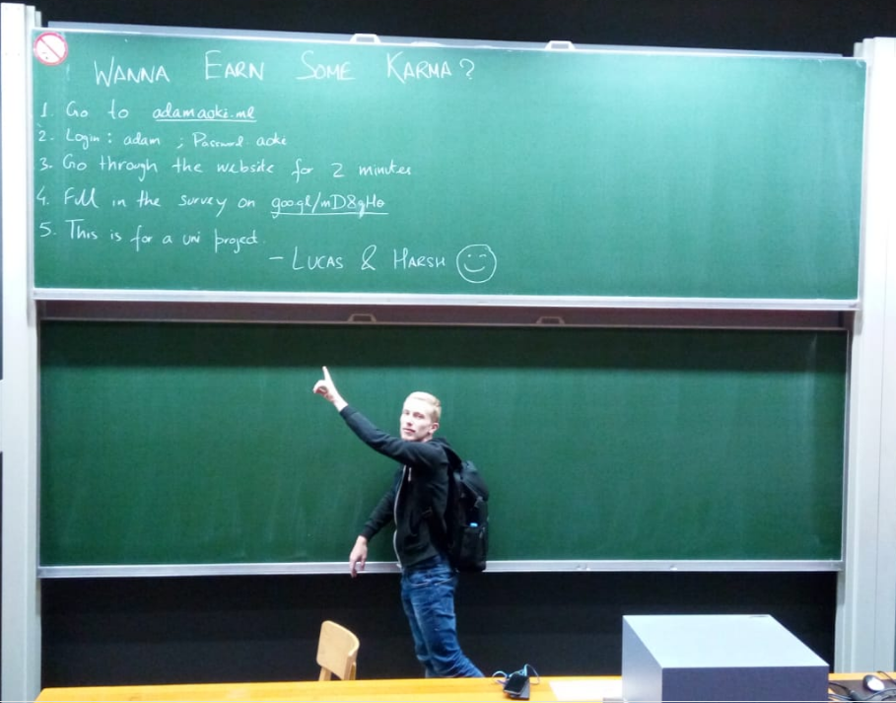
Testing

Slide 14
Feedback sessions & comparison with A&A mision/vision
Helpful comments during the feedback sessions
Continuous comparison to the A&A mission and vision

Slide 15
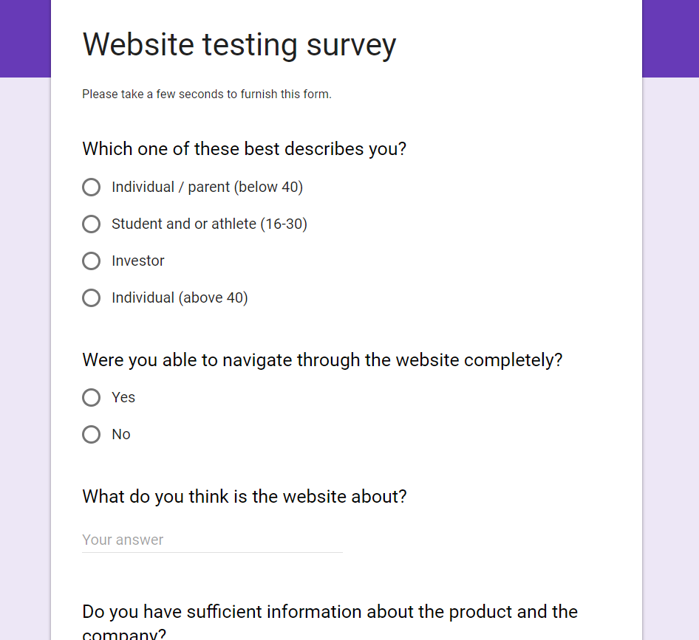
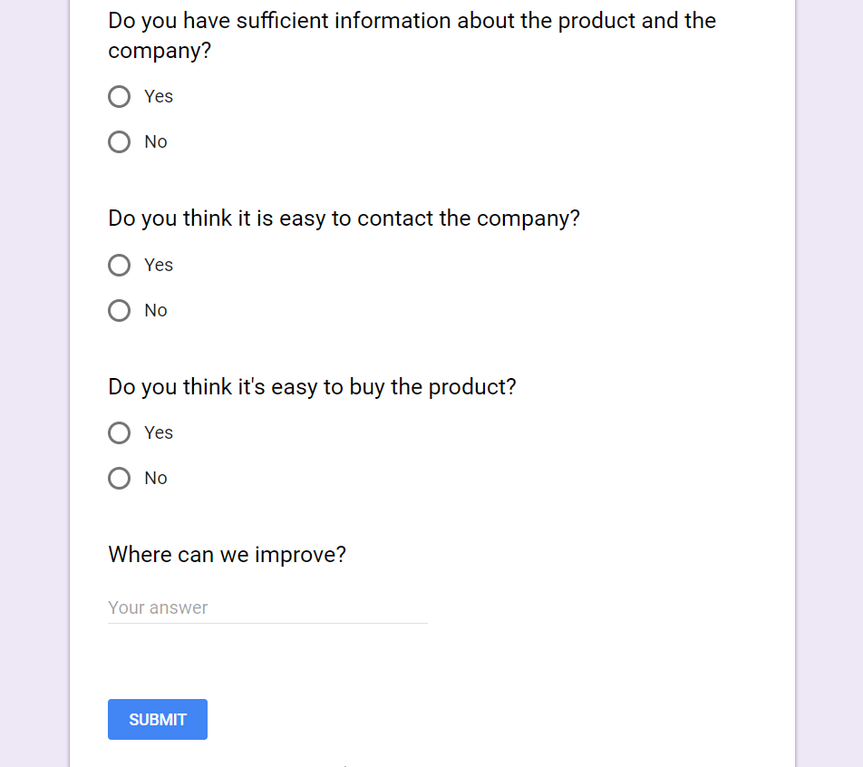
Survey
Strangers (matching our persona) went through our website
Feedback via a survey

Slide 16
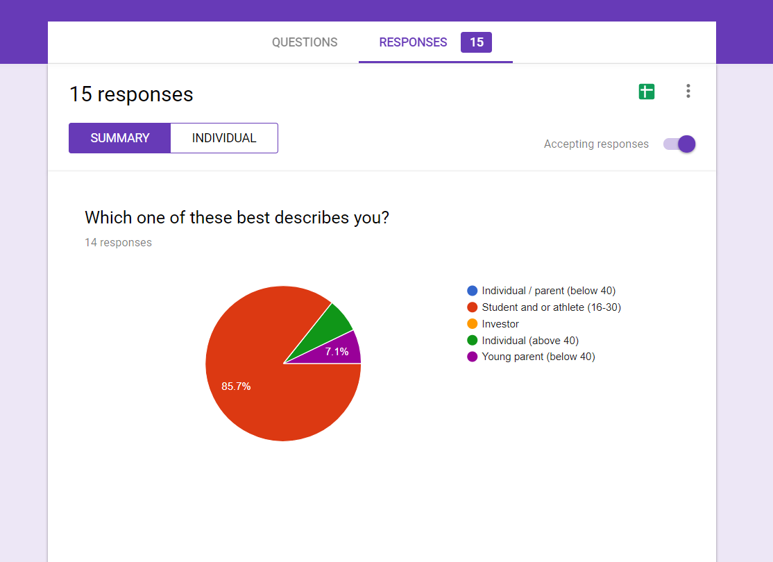
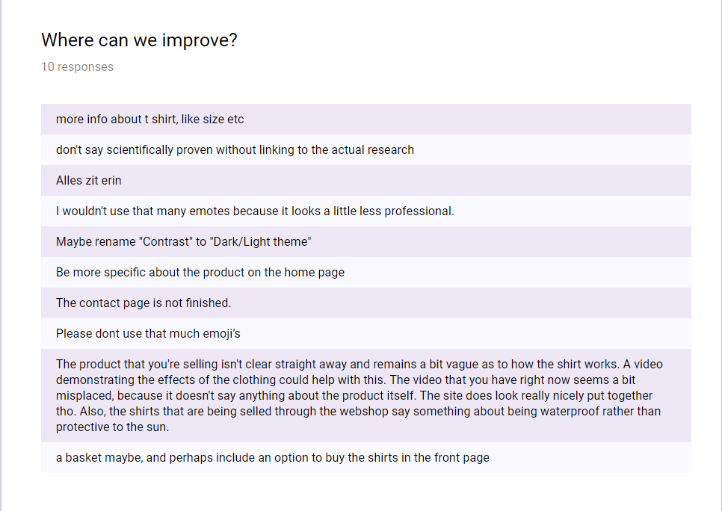
Building on feedback
Valuable comments by our personas upon our use cases
Refined website with testing twice.

Slide 17
Polishing

Slide 18
Conclusions drawn from testing
High priority
Accessibility
Responsiveness and interaction
It needs to tell a unique story
Information must be clear and to the point
Medium priority
Some sort of bonding/community feature
Get in touch easily with A&A staff
Fancy website to attract users

Slide 19
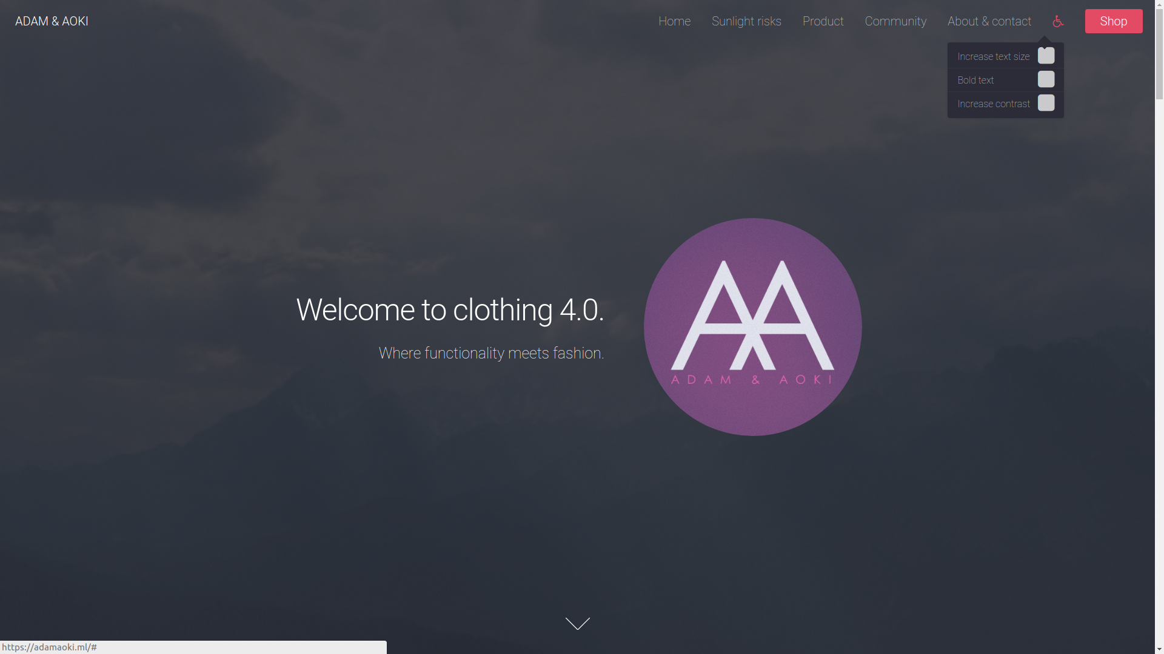
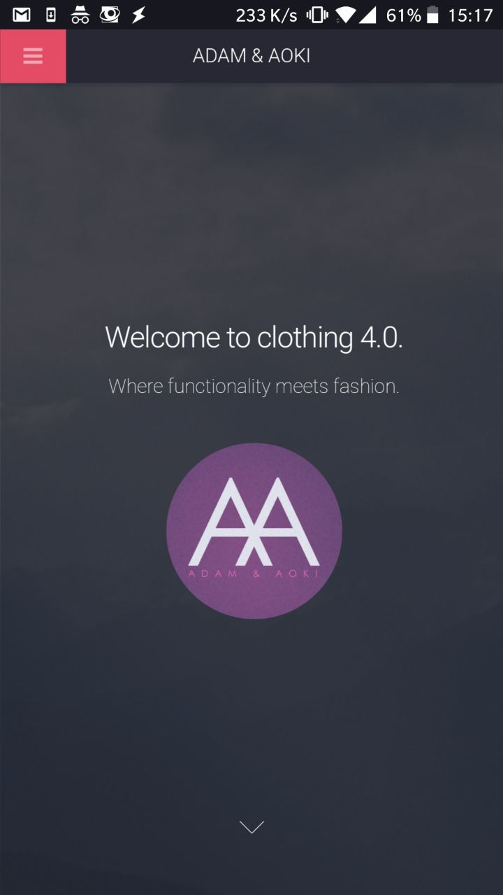
The result

Slide 20
Features
Accessibility
Information
Uniqueness
Community

Slide 21
Accessibility Features
Increased contrast
Makes all pages black and white (media preserves its colours)
Increased font size
Increases font size among all pages
Bold text
Increases font weight among all pages

Slide 22
Information Features
Product information
Information about the research, sizes etc.
Community
Where users can exchange their knowledge and experiences
Contact
Directly contact A&A via their phone,mail etc.

Slide 23
Uniqueness
Telling the powerful A&A story
Make them feel the authenticity of ADAM AOKI's foundation
The “Unique” experience
Innovative web experience
The best customer care

Slide 24
Community
Features & ideas
FAQ
Questions (from the forum) answered by A&A’s experts
Community Forum
Where users can exchange their knowledge and experiences.
Questions
Conversations or small-talk

Slide 25
We could give a demo now…...

Slide 26
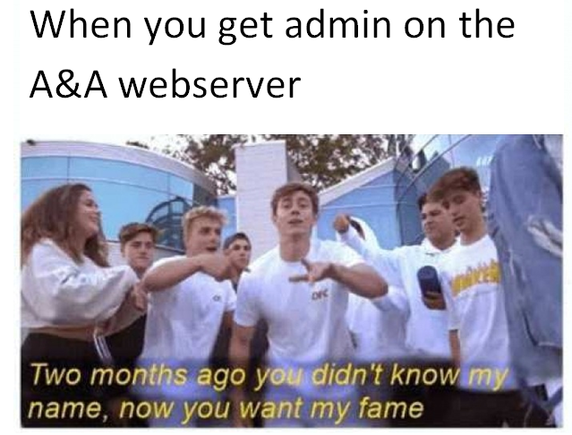
Or give yourself a live demo instead!
HTTPS://ADAMAOKI.ML
OR
HTTPS://WWW.ADAMAOKI.ML

Slide 27
Thanks for listening!

